Slide 2
Co-production and leadership: oil and water?
MSc Mental Health Recovery and Social Inclusion (Online)
https://www.england.nhs.uk/get-involved/resources/ladder-of-engagement-2/

Slide 3
Contributors
Dr. Audrey Campbell (co-presenter)
Mark Sanderson (student and co-presenter)
Karen Campbell (contributor)
Jane Chevous (contributor)
Simon Martin (contributor)
Peter Mwaniki (contributor)
Lisa Ngwenya (contributor)
Chelsea Norman (contributor)
Rosa Milne (contributor)
Tricia McNamee (contributor)
Annie Johnston (contributor)

Slide 4
Conference Themes
How we are addressing these themes:
HSK Learning and Teaching Online Conference 2021: Embracing Diversity and Change
Themes:
Celebrating innovation - the move to blended, flexible learning: including presentations exploring research, practice-based experience, good practice in Learning, Teaching, Assessment and Practice particularly exploring flexible, innovative approaches
Supporting success for BAME students: including shared examples of best practice, collaborative work with students, hints and tips, reports from projects/innovative work in academic, support, professional or practice settings

Slide 5
Mental health and co-production
Mental Health Recovery has been called a “transformation ideology”
Co-production originated in the US in the 1970s
Co-production now
Impact of co-production on staff

Slide 6
Co-production, our view
Nose to tail involvement and participation.
Role modelling and embedding principles of co-production through our teaching and learning approaches
Formative co-production exercises.

Slide 7
Why co-produce? Some reasons
NMC Standards for Learning and Teaching 2018
1.11 ensure programmes are designed, developed, delivered, evaluated and co-produced with service users and other stakeholders
5.5 curricula are co-produced with stakeholders who have experience relevant to the programme
Social Care Institute for Excellence ‘Co-production is a key concept in the development of public services. It has the potential to make an important contribution to all of the big challenges that face social care services.’
NHS England have a co-production model and a lot of resources. Alongside the rolling out of 5000 peer support workers with lived experience to work in the NHS over the next 5 years. Co-production is here to stay
https://www.england.nhs.uk/get-involved/resources/co-production-resources/

Slide 8
Policy and real world change
Why is it taking so long?
Appropriation and ‘dumbing down’ of the concept
Sterilisation
Professional’s use of a little bit of knowledge without understanding the philosophical base?
Professional arrogance?
Othering, them and us?
Thinking we know better?
(See Karen Campbell’s quote at the end)
The colonisation or sterilisation of the approach until it doesn’t really represent what it was meant to be and a losing sight of the activist survivor roots until it becomes meaningless. Professionalisation is dangerous.

Slide 9
Leadership and co-production in our teaching and learning
Values in action
Formative assessments in 3 modules are based on co-production exercises.
Final assignment of 7 across 3 modules is a short reflective piece.
Leadership style or no leadership at all?
Practice change

Slide 10
Equality & Access
Finished school at 18 with poor grades
Spent the majority of my 20s under mental health services
Informed on the importance of taking and engaging with services, and given a rather negative prognosis
Felt stunted by clinical treatments
Constant reinforcement of my ‘problems’
Had a large gap in my education
Could only find a handful of courses where you are welcomed to use your lived experience

Slide 11
Opportunities For Innovation
Prior to this course I was looking to study occupational therapy there was limited progression in peer support.
This course allowed me to stay in fulltime work and engage in education specific to my lived experience role.
The online platform supported me to plan my study around work, personal commitments and supporting my own wellbeing.
The learning materials were very relevant to my work in theoretically and practically.
The course had people from areas and backgrounds, which created a shared learning environment

Slide 12
Implementing Change
When starting the course I was as an associate mental health practitioner
During this course I got back into peer working, and now working in a lived experience leadership role
The course has supported my progression, which in turn has created progression for other peers
I was one of the first peer workers in my area in 2016, now there are 10 roles from NHS bands 3-6.
My breadth of knowledge developed through this course has landed me opportunities to educating others
The course literature highlighted a lack of lived experience specific CPD opportunities for peer workers
The confidence over this course has supported me to influence locally, nationally and internationally

Slide 13
The Pressure To Prove Myself Academically
Starting the course I was labelled as potentially manic and relapsing due to anxiety and excitement
Many expressed concerns and questioned if I was putting to much pressure on myself
The course learnings supported me to navigate a coercive situations and advocate for my own hopes
I have often felt tokenistic in my peer roles, and been used as a poster boy on occasion
Completing this course has supported gaining increased credibility
The perfectionist within me stemming from my cheffing days has created challenges, stress and great reward
My results exceeded my families and own expectation

Slide 14
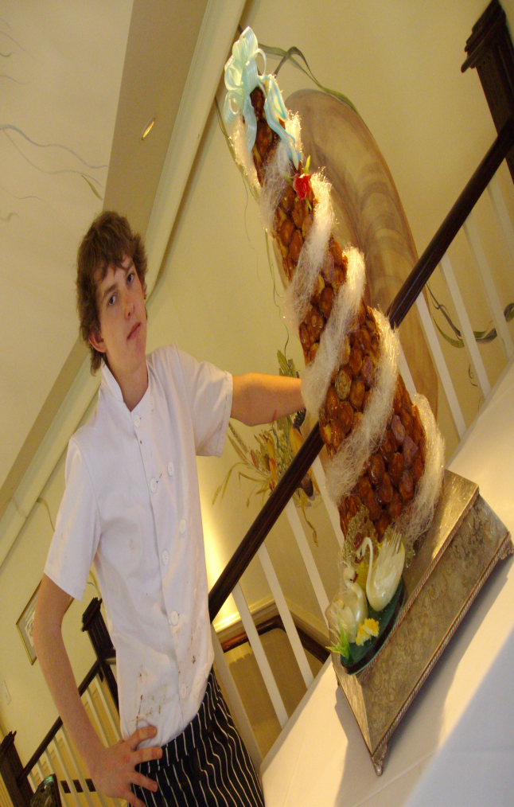
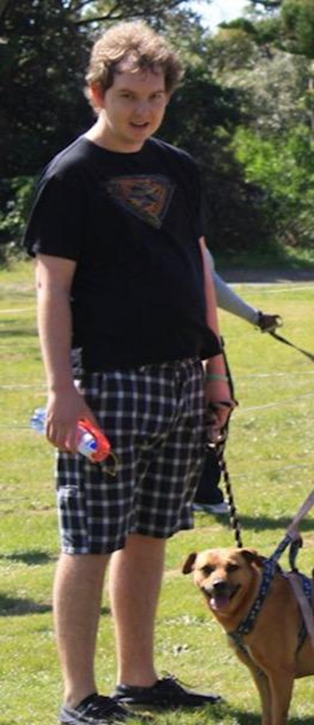
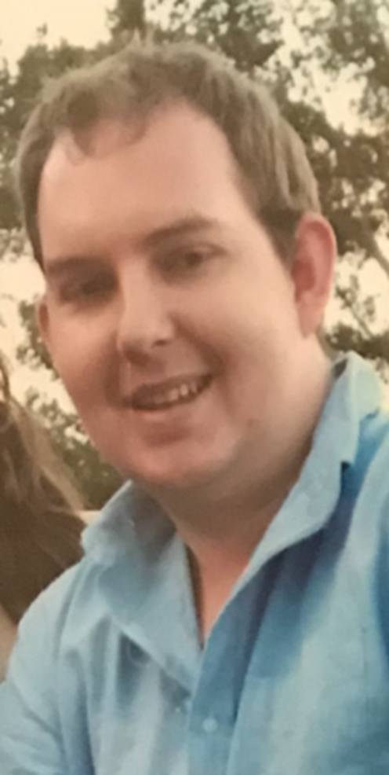
From a hopeful chef
2009
2011
2012

Slide 15
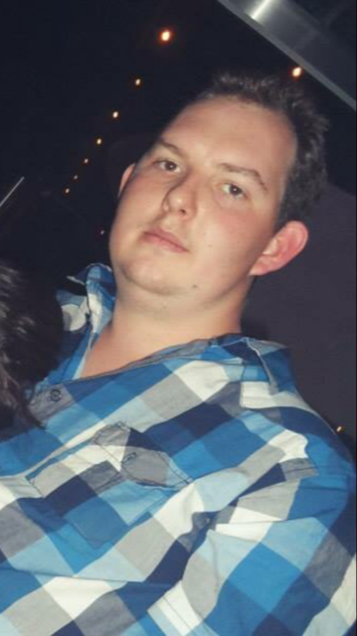
To a young man trapped in the mental health system
2013
2014
2015

Slide 16
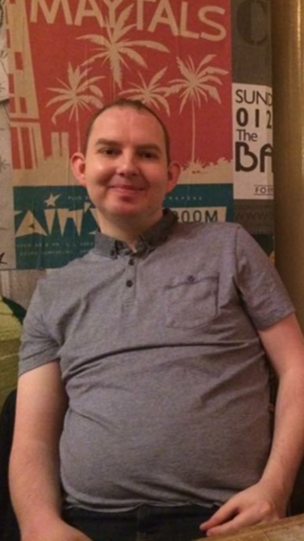
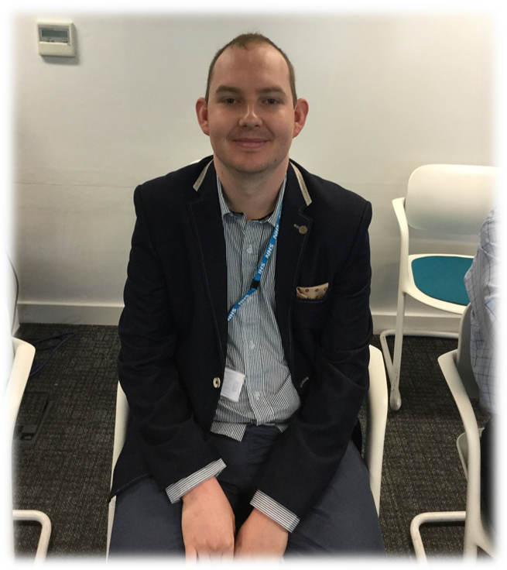
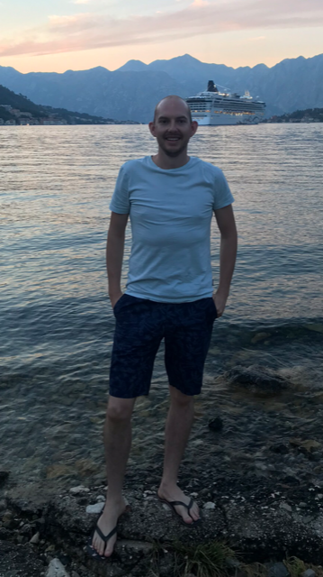
Serious mental illness is not always forever and should not exclude people
2016
2017
2018

Slide 17
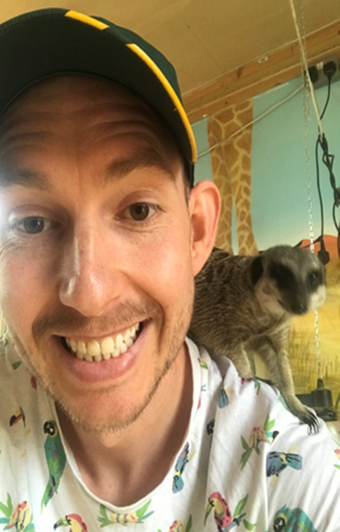
Nor should it define whether people are capable or not of completing higher education
2019
2020
My hard work and hunger to make positive changes in mental health services have reaped positive results
I have finished with 92% over my seven graded assignments, of which four I received 95%

Slide 18
The students speak better than us
This piece has provided a critical reflection on the position of a newly qualified occupational therapist transitioning into practice to influence recovery-oriented change. Through an exploration into the meanings of recovery and newer understandings, it is evident that practitioners need to focus on service users’ goals relating to recovery and adopt appropriate leadership styles to support such practices: co-production and service user leadership are two examples explored (SCIE, 2008). As a relevant stakeholder, a newly qualified practitioner has the potential to influence innovation and leadership styles that support recovery-based practice, however whilst there are opportunities to enhance practice, there are also challenges including fixed professional attitudes (White, 2013) Annie Johnston

Slide 19
As a newly trained MHFA instructor I was initially only aware of the medical model of treatment in mental health care. This consisted of paternalistic ideals and a belief that the professionals knew best (Slade, 2013). The medical model of treatment influenced the way in which I delivered my courses which was authoritative and rigid. I believed that professional expertise trumped individual experience. I believed that there needed to be a clear distinction between me as the instructor and my learners. Nevertheless, I did not see myself as a leader I thought leadership was an assigned role or some mystical endowment for a chosen few. Tricia McNamee

Slide 20
This course has been transformative in a way I did not envisage when signing up to it. Mainly, it has helped me find a place in an overwhelming concept and its derivative systems, mental health and its care and treatment. My identity, which has not been examined or considered for many years, has been explored and developed. Secondly, my boundaries and values have been tested and have taken a precedence I did not fully allow before in work or study. And thirdly, my views on facilitating and leading change have altered and expanded. Leadership was something that, before starting this course, I believed to be akin to management and my experiences of this were top down, hierarchical, and rarely positive.
Rosa Milne

Slide 21
This reflection on the management decision and the literature reviewed illustrates, risk aversion is widespread in mental health services (Morrissey & Higgins, 2019; Waldemar et al., 2016). This is driven by the deeply entrenched paternalism in the sector (Groot el al., 2020; Waldemar et al., 2018); the widespread blame culture within the sector and the wider society (Morrissey et al., 2018; Morrissey & Higgins, 2019); and a combination of other organisational factors (Frost et al., 2017; Nugent et al., 2017). As a practitioner I find this to be demoralising and frustrating as it impedes my professional development and undermines my ability to embed recovery oriented practice which recognises therapeutic risk taking as an integral component of personal recovery (Farr, 2018; Gee et al., 2017). ‘‘What good is it making someone safer if it merely makes them miserable?’’ is a widely quoted statement credited to Justice Munby in his ruling regarding the importance of balancing the duty of care and promoting human rights for service users perceived as vulnerable (2007, para 120). It is incumbent for mental health providers and practitioners to borrow a leaf from this sagacious statement and recognise the deleterious consequences on service users’ wellbeing and recovery caused by a plethora of risk averse decisions they routinely implement. Peter Mwaniki

Slide 22
Service user outcomes may be greatly influenced by the formation of interpersonal relationships between nursing staff, which is mostly pioneered by proactive leadership. Successful leader and follower relationships among staff, according to Cummings et al. (2010), result in positive recovery outcomes, while suboptimal leader and follower relationships can lead to suboptimal treatment .
As a nurse, it is therefore critical to understand essence of leadership and its impact on day-to-day nursing. Research shows a correlation between an effective nursing leadership, and retention of nursing staff, a positive work environment, and improved service user recovery outcomes (Wong et al., 2013; Murray et al., 2018). Lisa Ngwenya

Slide 23
Until recently, I held the view that to be an effective leader within a healthcare setting, or in fact to lead change, that individual had to demonstrate autocratic leadership traits. I believed that I could not lead change as I do not define myself as an assertive individual. It would appear that this belief has been shaped by societal beliefs and prejudices. An article written by Bongiorno et al (2013) highlighted that there is a level of prejudice, particularly towards women, in relation to assertiveness within a leadership role. The authors found that women failing to show agentic behaviour, akin to myself, were found to be less likeable. More importantly, they were found to be less influential which is likely to impact the level of change that they can initiate. The authors do go on to state that this stereotypical belief has reduced over time, though it has not been eradicated. There are also several examples, both as a service user and as a student, that have demonstrated the point that a leader does not have to exert power and take a dominant stance...

Slide 24
Overall, this whole course has changed my outlook on leadership as well as the mental health services. First and foremost, I have recognised that I am able to utilise my own experiences in order to promote positive changes. Therefore, I can reflect upon a period of my life where I was unwell and in a state of distress and now use this in a positive way. I have also recognised that my personal characteristics, such as being slightly reserved and not particularly assertive, do not detract from my ability to lead change. In fact, as the previous points show, it appears that it is more beneficial for a leader to actively listen to others and work in collaboration as opposed to being a dictator. Taken this into consideration, if I were to move into a leadership role, I would aim to work in a way that promotes transformational leadership rather than autocratic leadership. It is also important to note that there are a number of other leadership styles and theories but throughout the course, and in particular the leadership module, these are the two approaches that stood out to me. Finally, as a service user, I am very passionate about changing the way that mental health services are run, as well as reducing the stigma of mental illness. I strongly believe that professionals and service users should work in partnership, particularly as I know this played a big part in my own recovery journey. Chelsea Norman

Slide 25
I worked on personal deficits I identified such as wanting to be innovative but initially not realising I had to change first. I realised I had to ‘act out’ the change, let other professionals see the change within myself and project this outwards. Karen Campbell
Reflection can often be a painful process and in relation to this assignment it has been an experience that has created examination of my attitudes and behaviour in regard to developing leadership. Boud et al. (1985) describe this process as consciously looking at considering how behaviour, experiences and emotions can be interpreted as a positive learning experience. For me, personally, this has resulted in an in-depth scrutiny of personal assumptions, values and beliefs that can influence professional practice (Fletcher et al., 2010). Simon Martin

Slide 26
This process has unfolded so clearly through the course, especially as a student with lived experience. The knowledge and awareness we have gained from the course materials has been enriched by the collaborative learning approach, that has brought together practitioners and people with lived experience in a shared space where we can be equals. Mental health professionals amongst my peers have related how they have a greater understanding of service user perspectives. My enhanced skills in research and academic writing have enabled Survivors Voices to produce publishable research and improve our peer support and survivor activism practice. Other life changes have both contributed and sabotaged putting all my learning into practice. But overall I can recognise that the course has given me a confidence and resolve in my leadership which has lifted us from a small bunch of volunteers to a focussed, skilled and effective user-led organisation that is achieving far more than its tiny resources would suggest. It’s a little miracle and this course has been so instrumental in our transformation. Jane Chevous

Slide 27
Reference list
National Health Service. Ladder of Engagement. NHS. Retrieved June, 14, 2021 from
https://www.england.nhs.uk/get-involved/resources/ladder-of-engagement-2/
Nursing and Midwifery Council. (2018). Standards for Education (2018). NMC. Retrieved June, 14, 2021 https://www.nmc.org.uk/education/standards-for-education2/
Social Care Institute for Excellence. (2015). Co-production in social care: what it is and how to do it - At a glance. SCIE. Retrieved June, 14, 2021 from https://www.scie.org.uk/publications/guides/guide51/at-a-glance/

